Slide 1
Azure

Slide 2
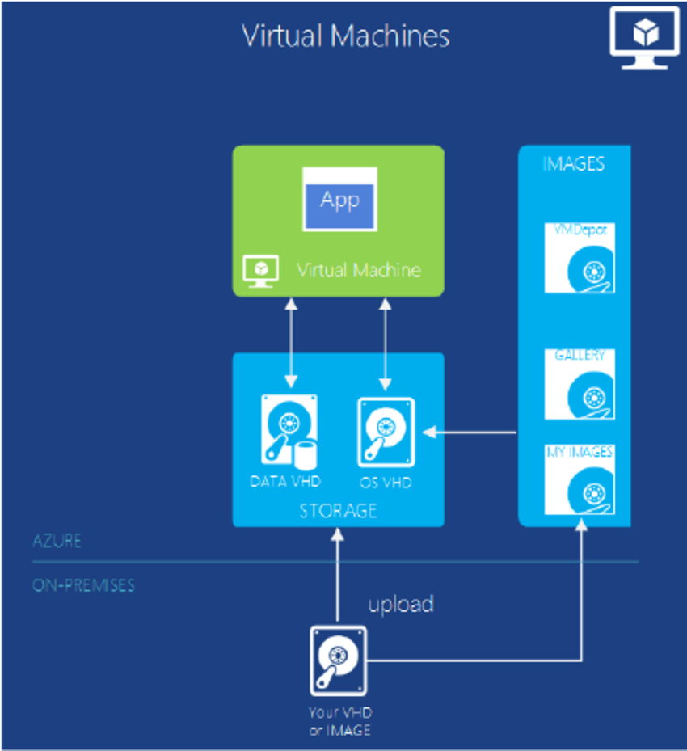
Azure VM

Slide 3
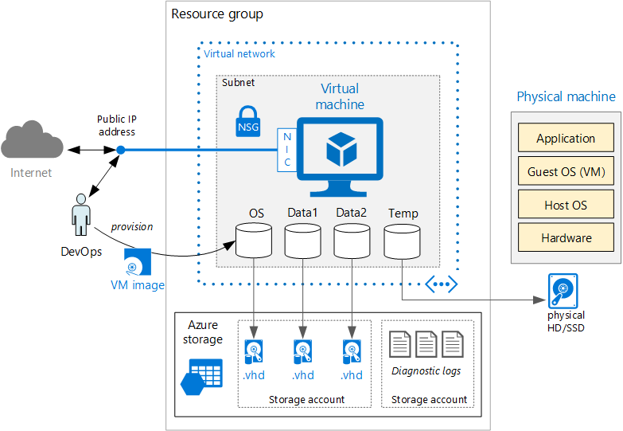
Azure VM, Subnet, VNet, Resource Group

Slide 4
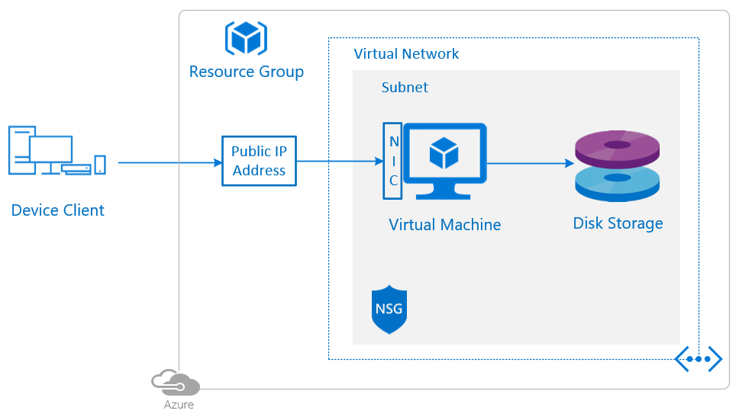
Azure VM, Subnet, VNet, NSG, Public IP, Disk

Slide 5

Azure VM, Subnet, VNet, NSG, Public IP, Disk

Slide 6
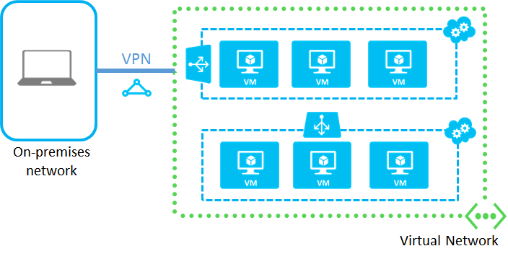
Azure VPN

Slide 7
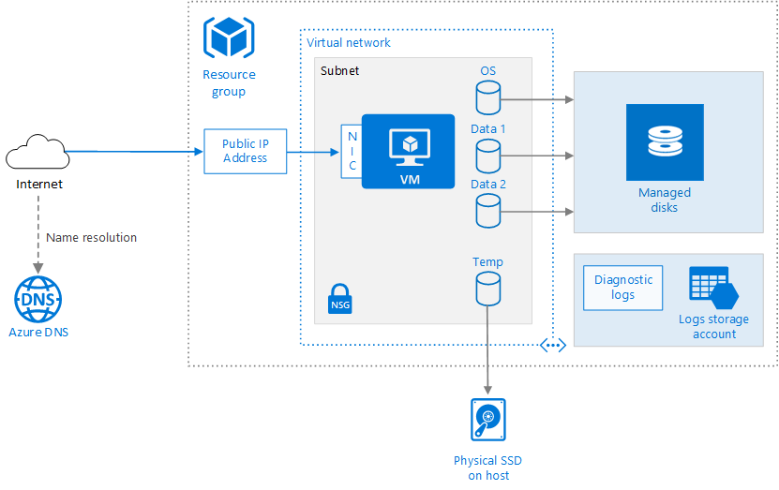
Azure VM, Subnet, VNet, NSG, Public IP, Disk

Slide 8
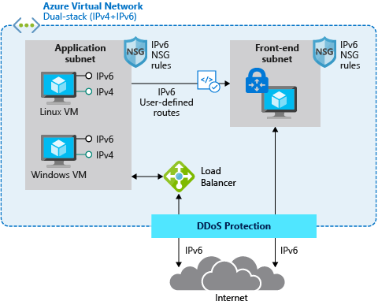
DDos Protection, Load Balancer

Slide 9
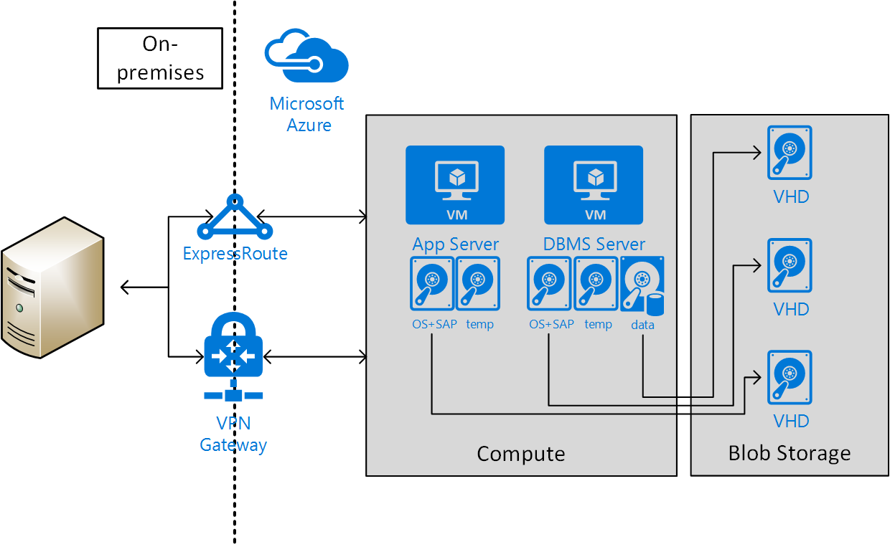
VPN Gateway, Express Route

Slide 10
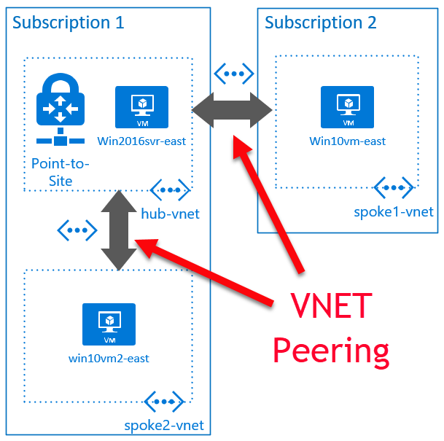
VNet Peering

Slide 11
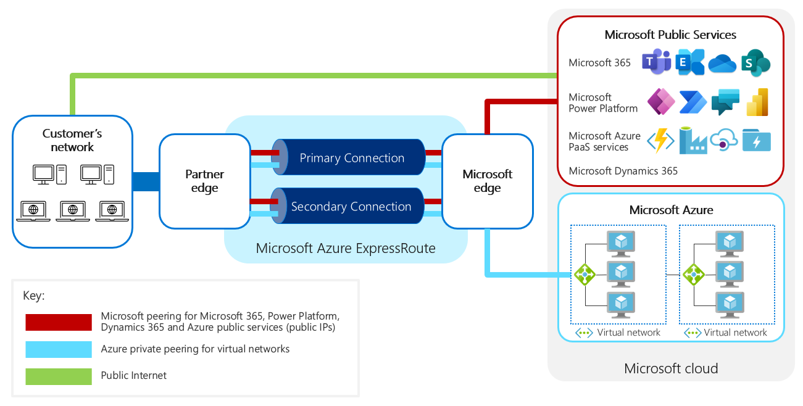
Express Route

Slide 12
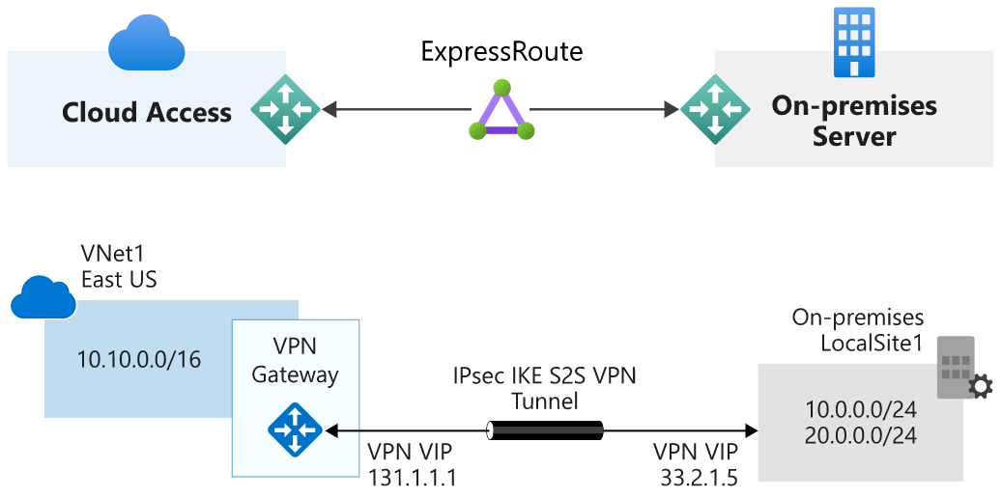
Express Route vs VPN Gateway

Slide 13
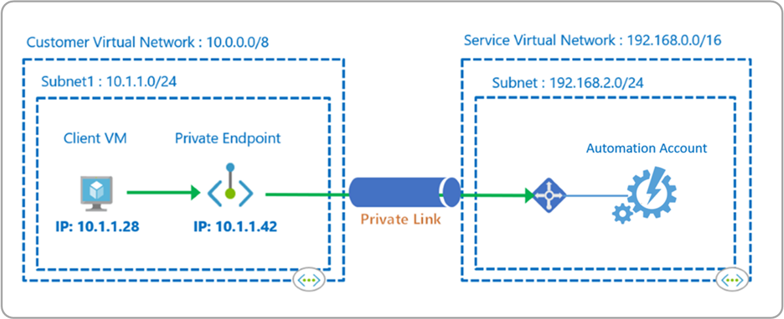
Private Endpoint

Slide 14
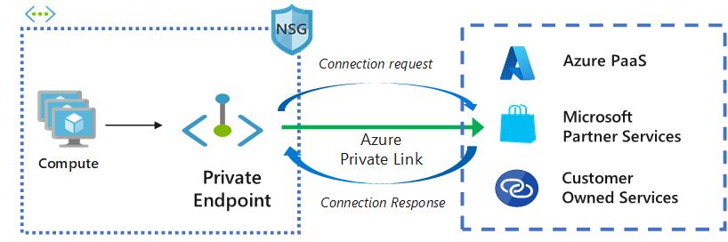
Private Endpoint

Slide 15
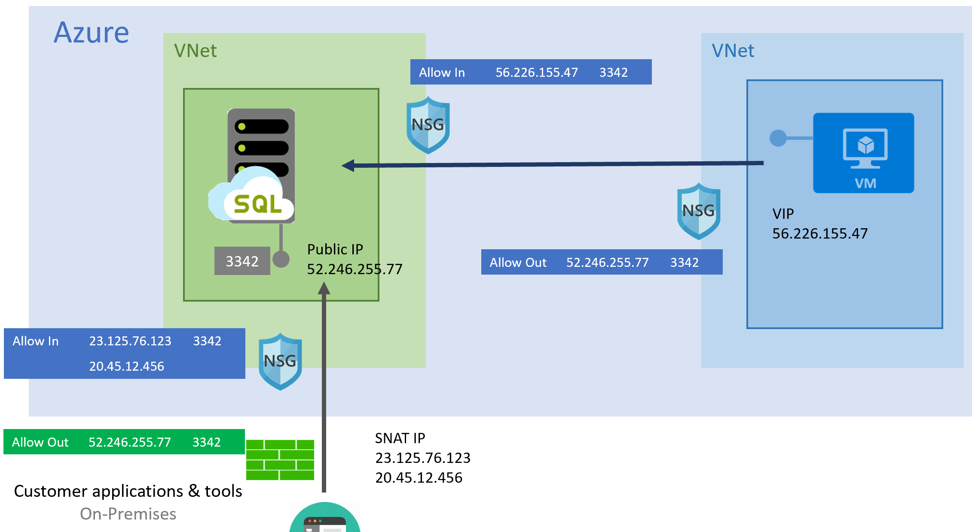
Public Endpoint

Slide 16
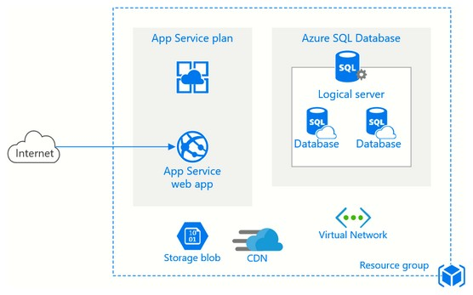
Azure App Service

Slide 17
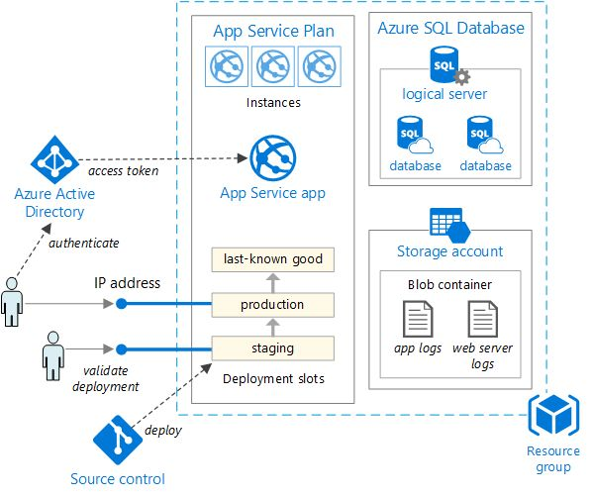
Azure App Service

Slide 18
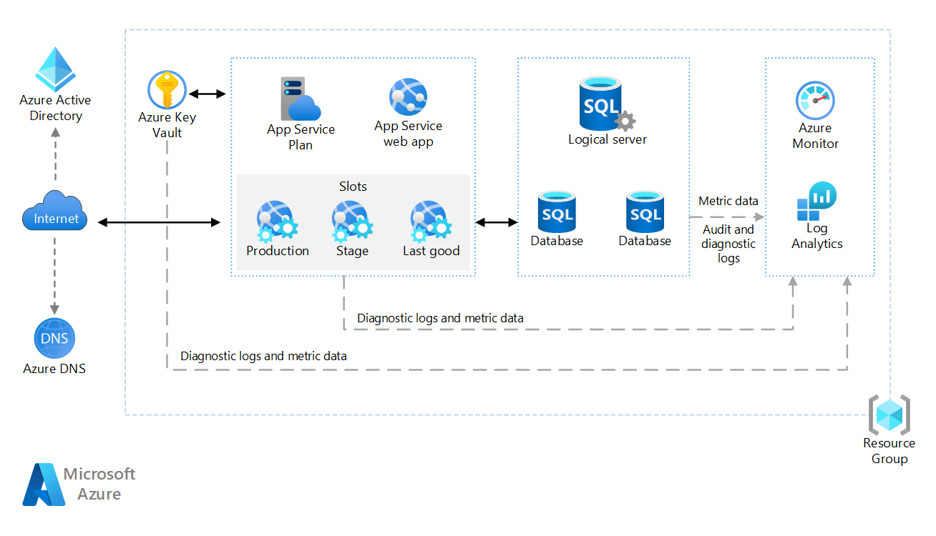
Azure App Service, Key Vault, Monitor, DNS

Slide 19
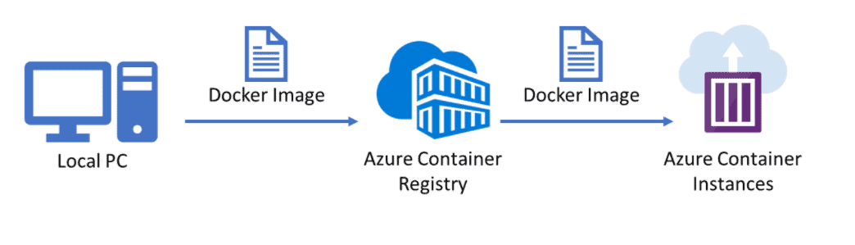
Azure Container Instances

Slide 20
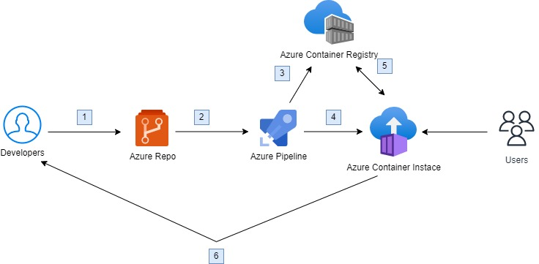
Azure Container Instances

Slide 21
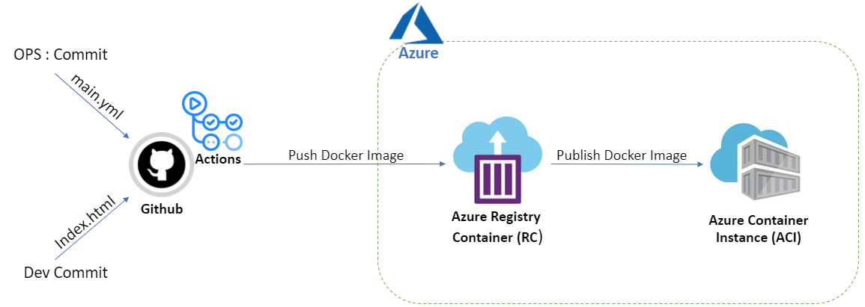
Azure Container Instances

Slide 22
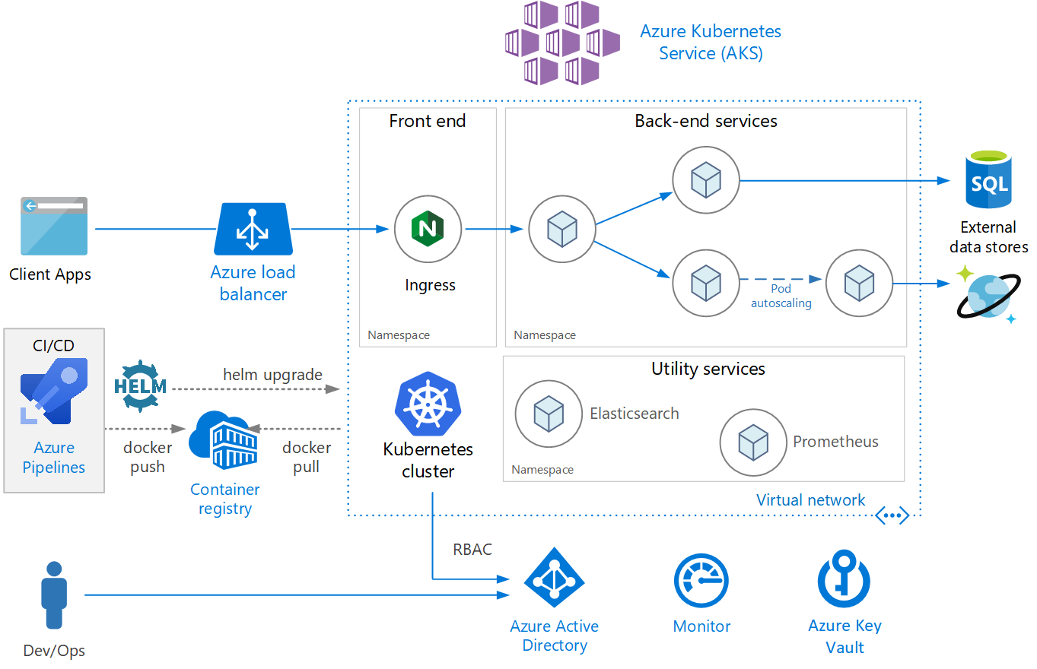
AKS

Slide 23
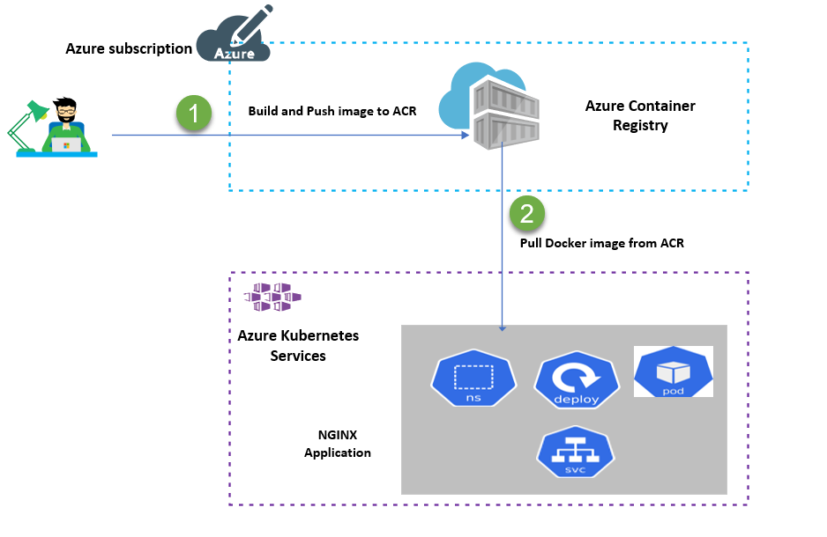
AKS and ACR

Slide 24
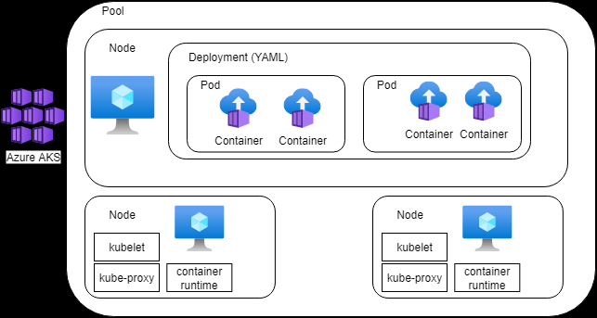
AKS Nodes and Pods

Slide 25
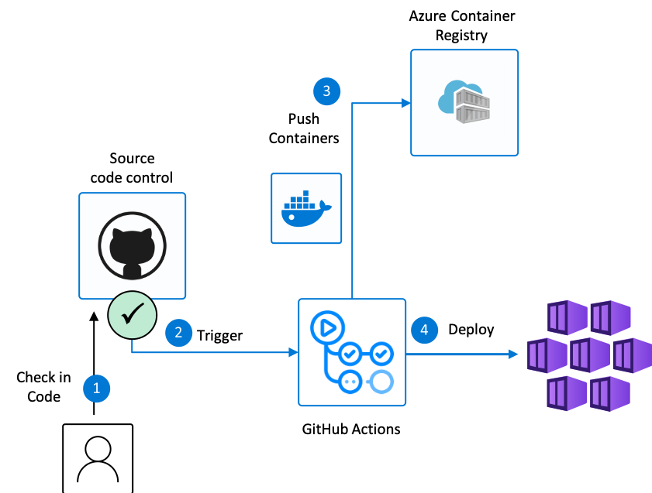
DevOps flow to deploy to AKS

Slide 26
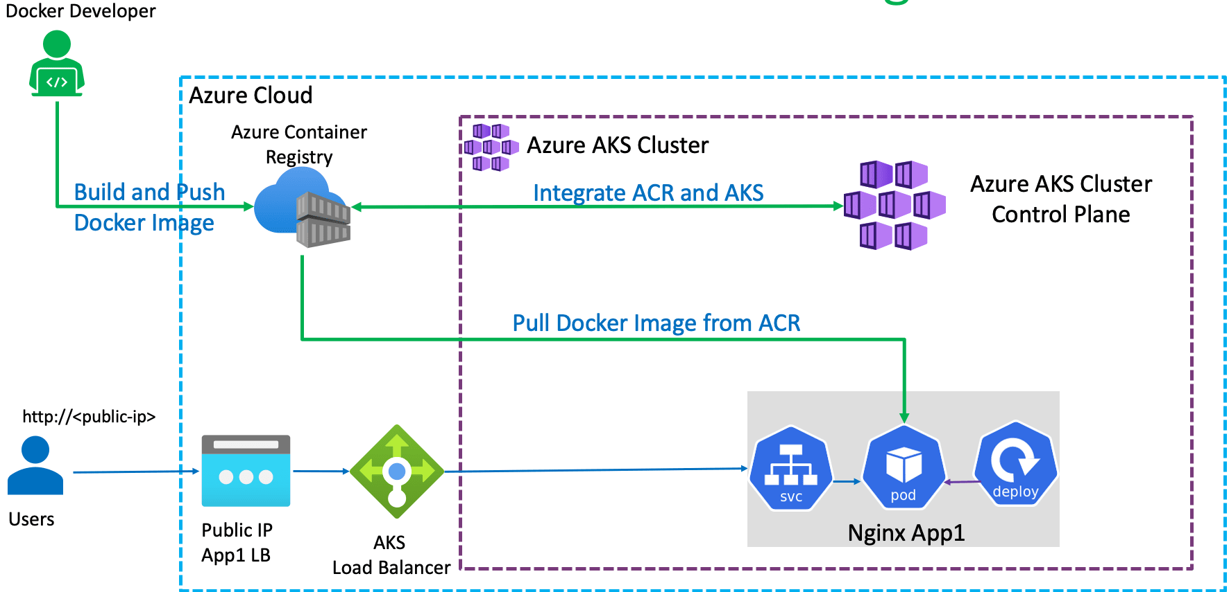
Azure ACR and AKS Integration

Slide 27
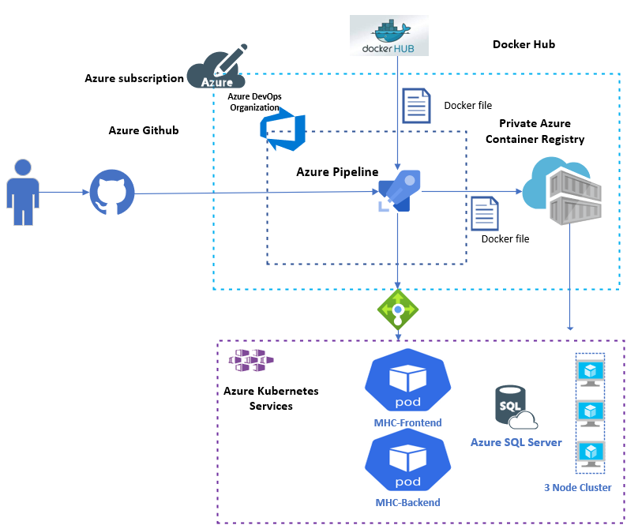
Azure DevOps and AKS

Slide 28
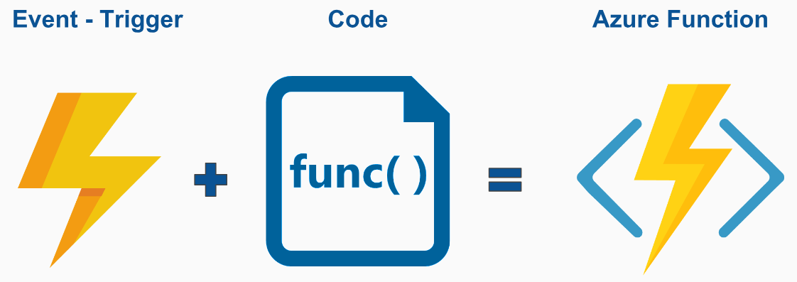
Azure Function

Slide 29
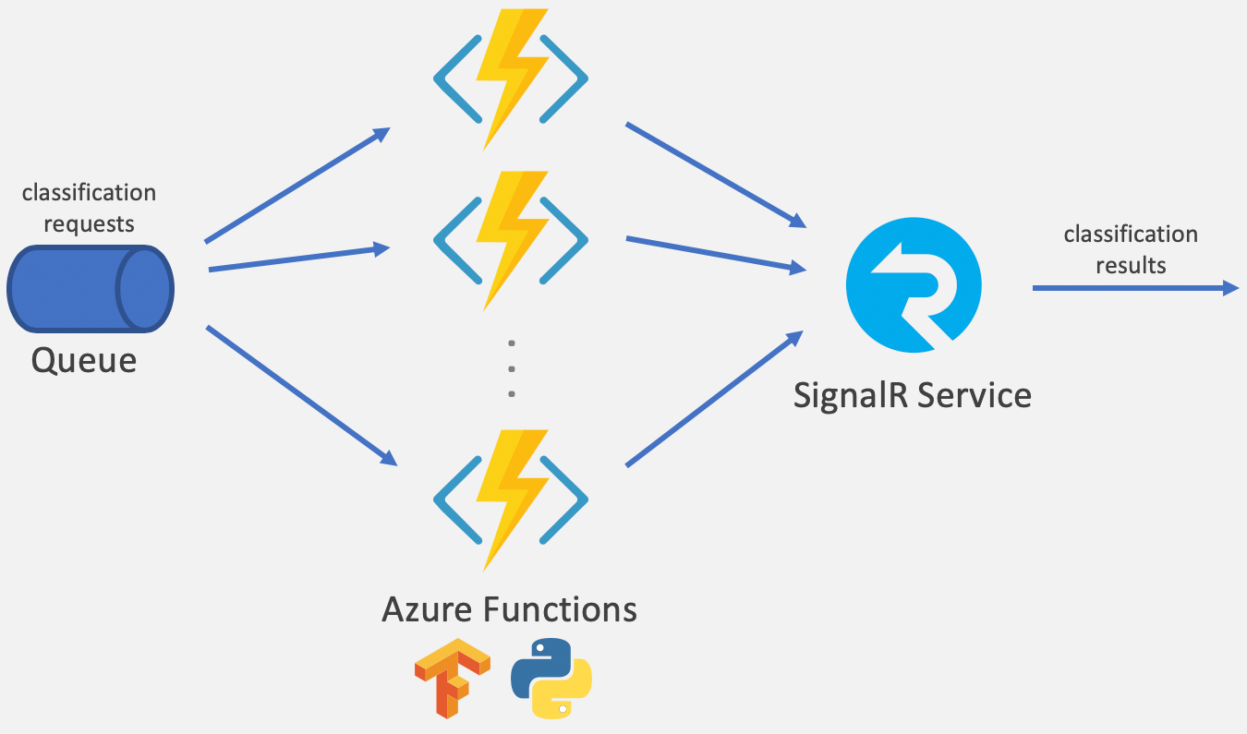
Azure Function

Slide 30
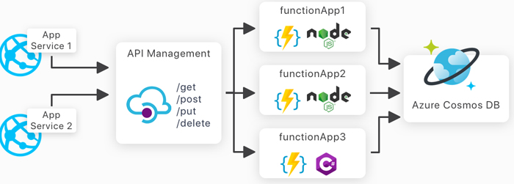
Azure Functions and API

Slide 31
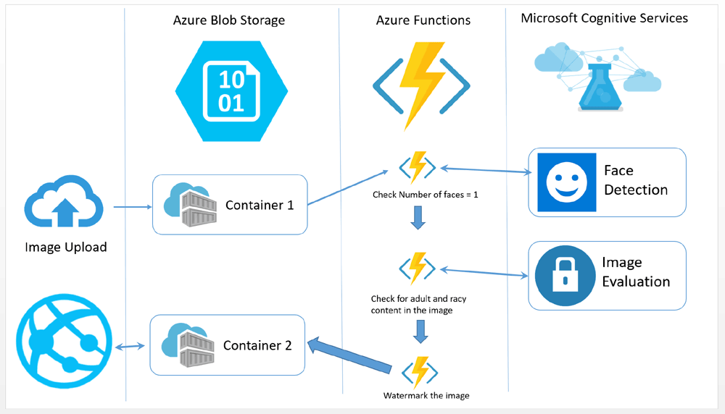
Azure Functions and Cognitive Services

Slide 32
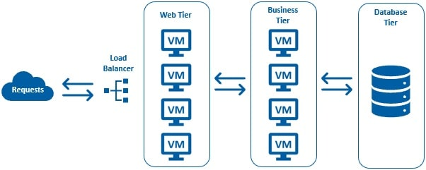
Azure VMSS

Slide 33
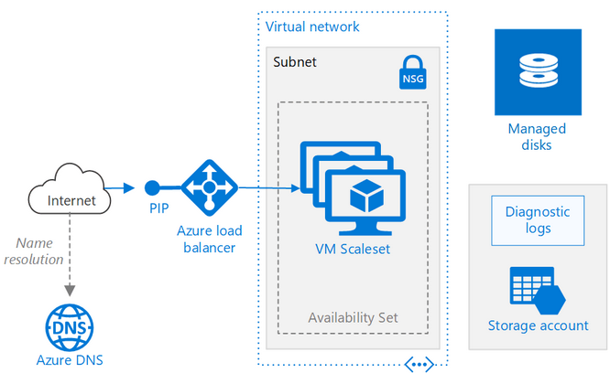
Azure VMSS

Slide 34
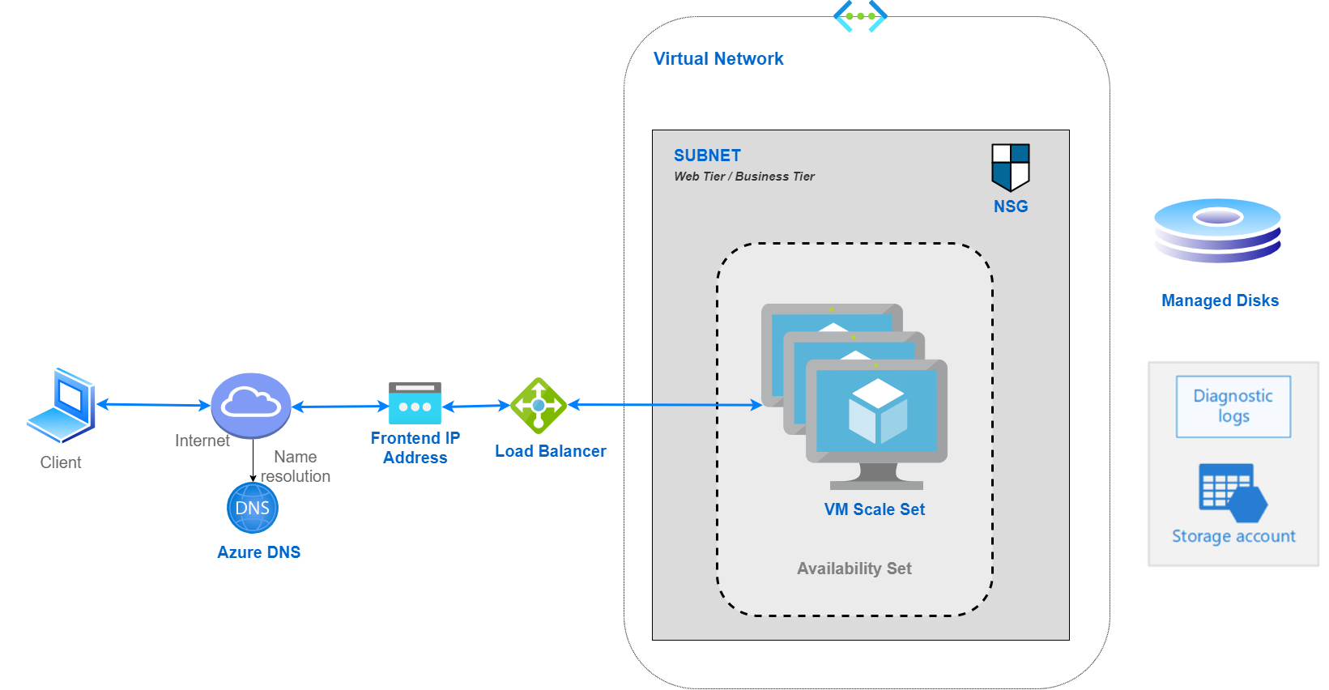
Azure VMSS

Slide 35

Azure VMSS

Slide 36
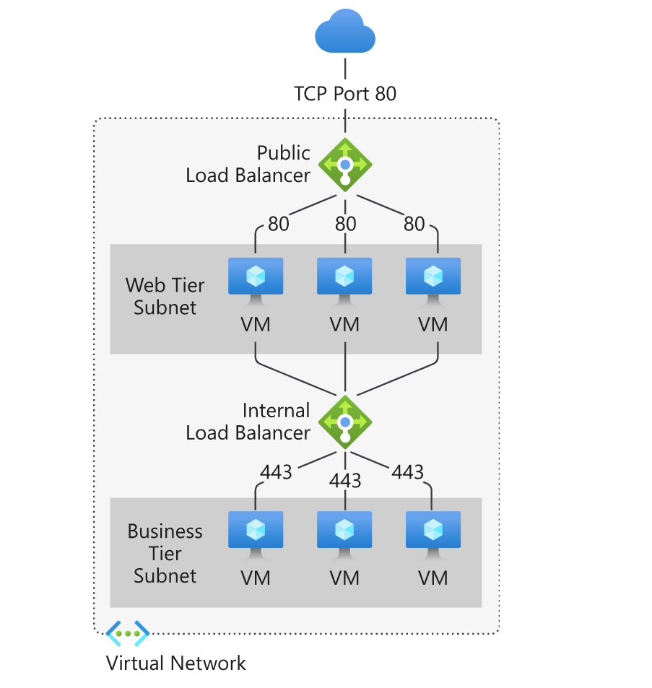
Azure VMSS

Slide 37
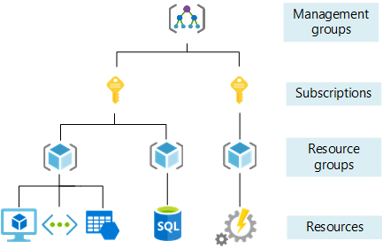
Azure Management Group and Subscription

Slide 38
Azure Management Groups
Azure Management Groups, Subscriptions, and Resource Groups are used together to establish the entire organizational structure in Azure
Designed to be flexible to organize Azure resources to meet business needs.
Azure management groups provide a level of scope above subscriptions
Azure provides four levels of management scope:
Management groups
Subscriptions
Resource groups
Resources

Slide 39
Root management group for each directory
Each directory is given a single top-level management group called the root management group
This root management group allows for global policies and Azure role assignments to be applied at the directory level

Slide 40
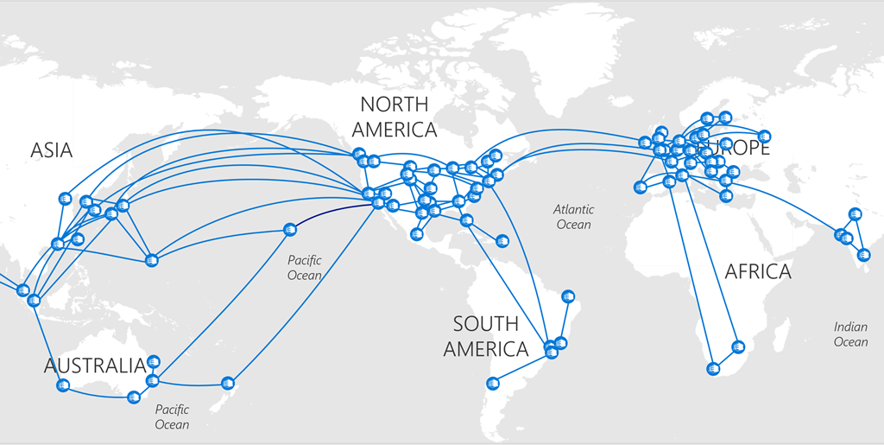
Azure Regions

Slide 41
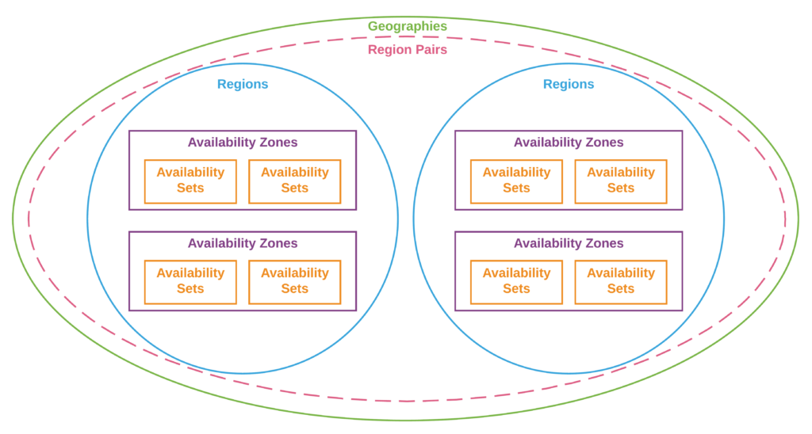
Azure Regions

Slide 42
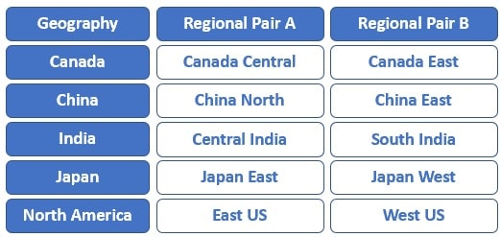
Azure Regions

Slide 43
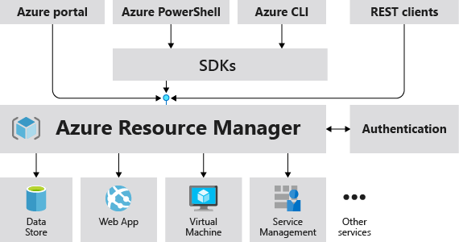
Azure Resource Manager

Slide 44
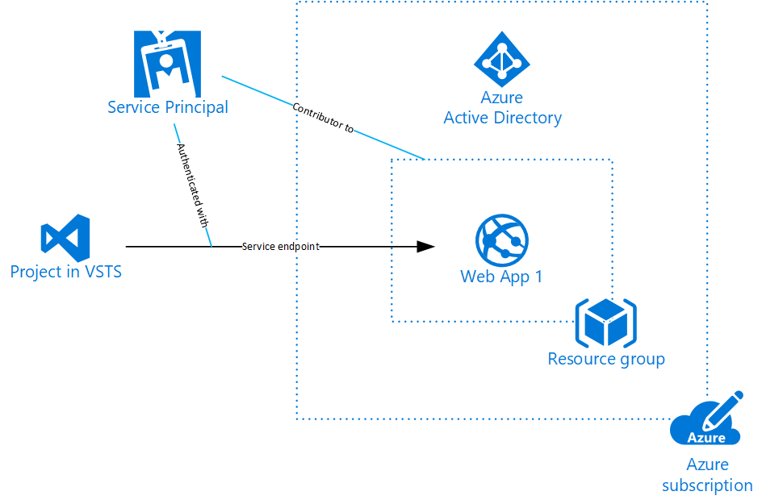
Azure Service Principals

Slide 45
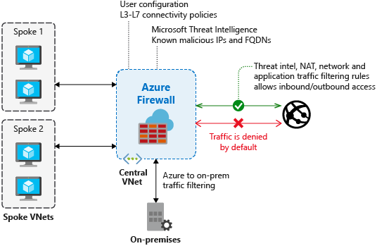
Azure Firewall

Slide 46
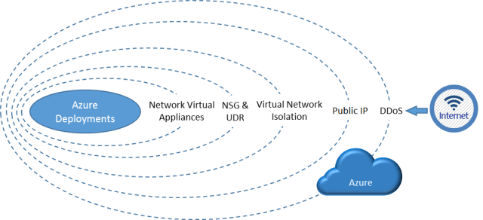
Azure DDos Protection

Slide 47
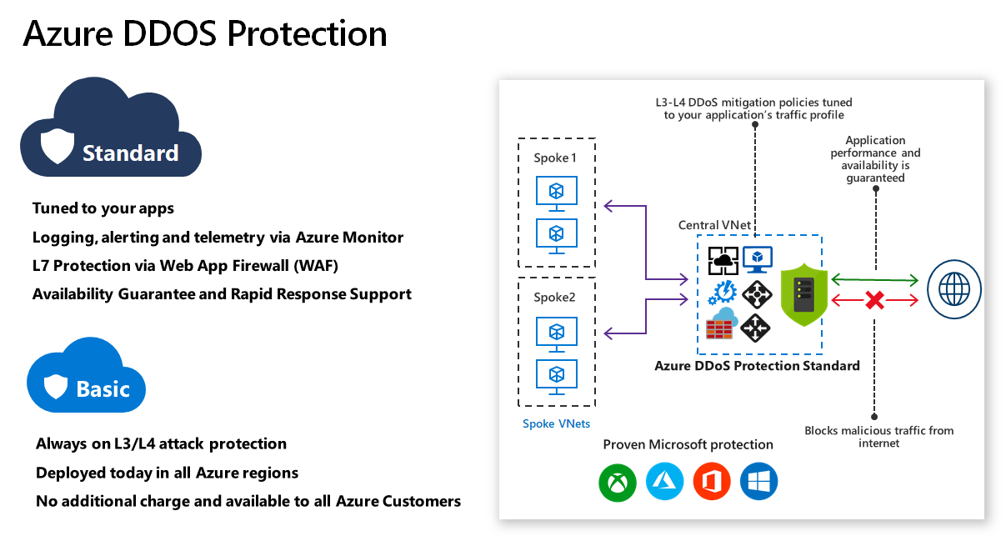
Azure DDos Protection

Slide 48
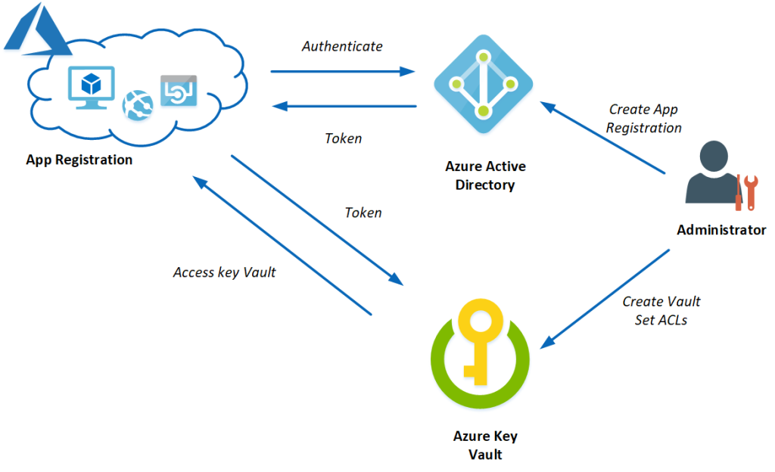
Azure Key Vault

Slide 49
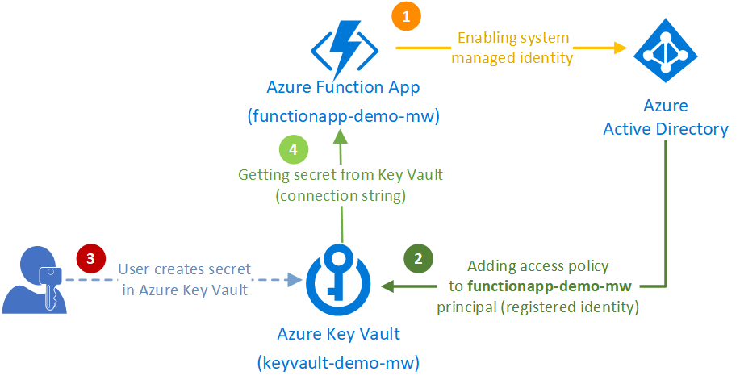
Azure Key Vault

Slide 50
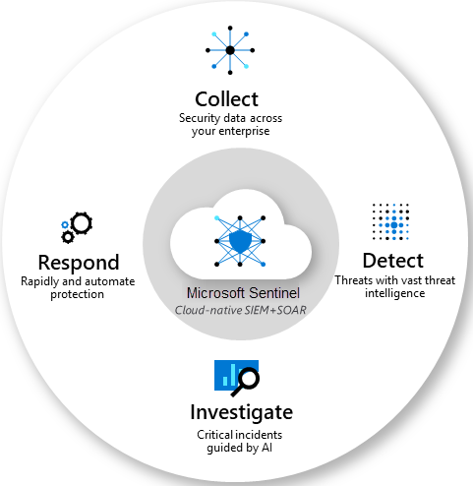
Microsoft Sentinel

Slide 51
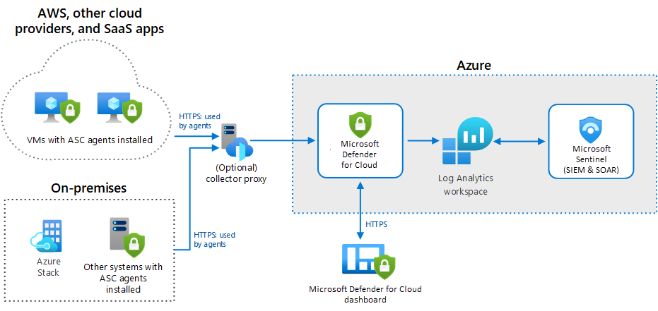
Microsoft Sentinel

Slide 52
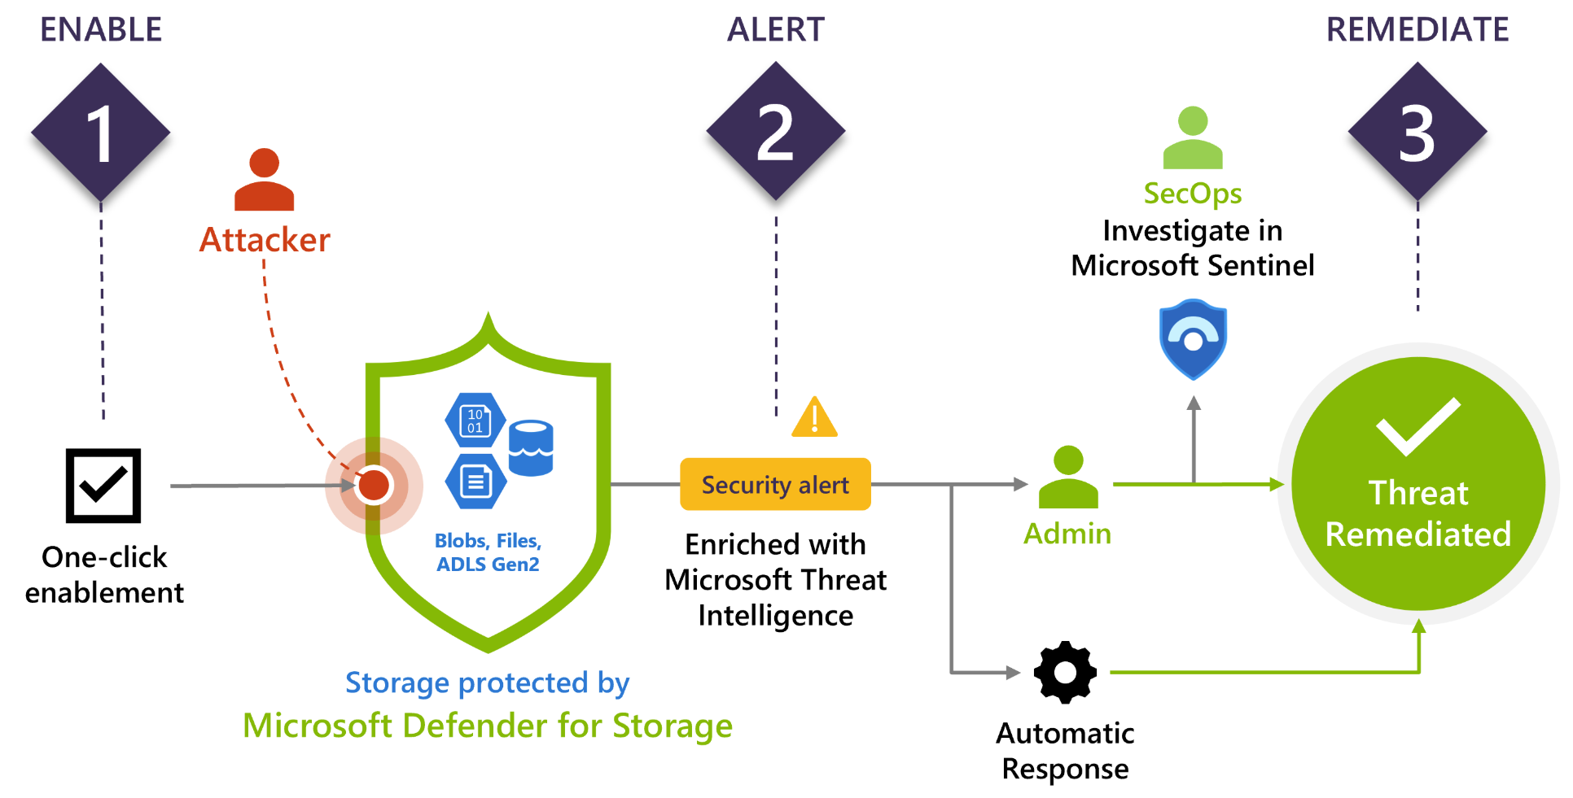
Microsoft Defender for Cloud

Slide 53
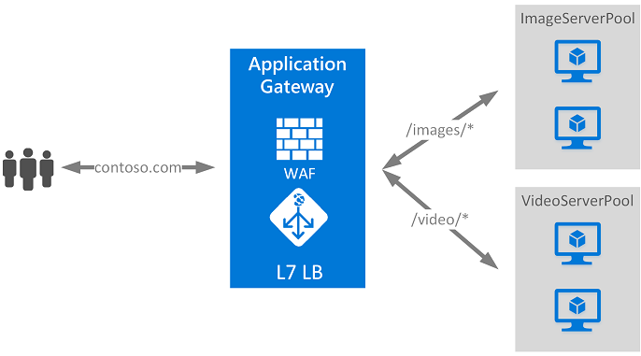
Application Gateway

Slide 54
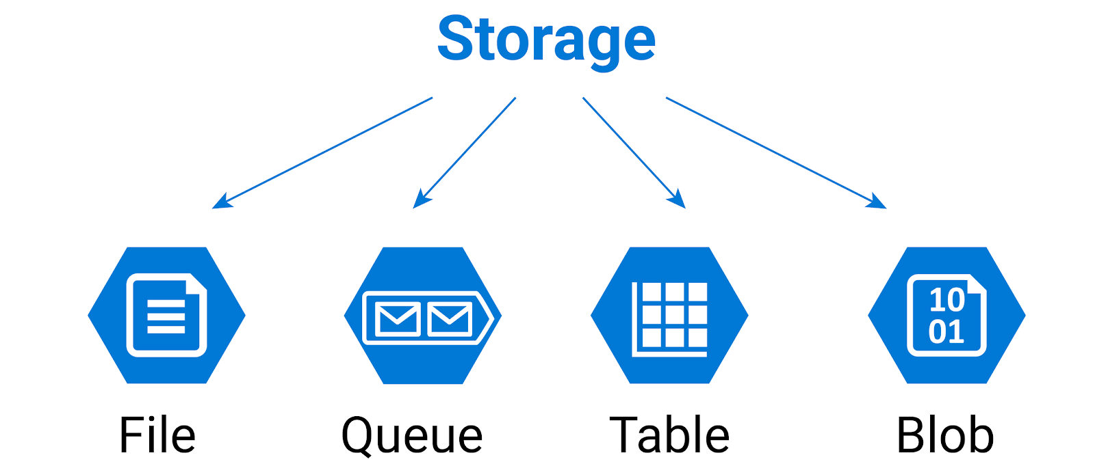
Azure Storage

Slide 55
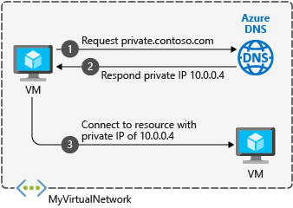
Azure DNS

Slide 56

Azure DNS

Slide 57

Azure Advisor

Slide 58

ARM Templates

Slide 59

Azure Monitor

Slide 60

Azure Service Health

Slide 61

Azure Service Health

Slide 62

Azure Log Analytics

Slide 63
Azure identity, governance, privacy, and compliance

Slide 64

Azure Authentication and Authorization

Slide 65

Azure AD

Slide 66

Azure RBAC

Slide 67

Azure Resource Locks

Slide 68
Azure Cost Management

Slide 69

Cost Management

Slide 70

Pricing Calculator

Slide 71
Thanks

